Slide 1

Body Fat Assignment
Stat 628 Module 2
RUI HUANG
CHENYANG JIANG
HanGyu KANG
ENZE WANG

Slide 2
Introduction
Body Fat Percentage = Total Mass of Fat / Total Body Mass.
A precise way to measure body fat is to combine submersion method with Siri equation (Body fat=495/Density-450). But it is difficult.
Our group want to figure out a convenient way to predict body fat.

Slide 3
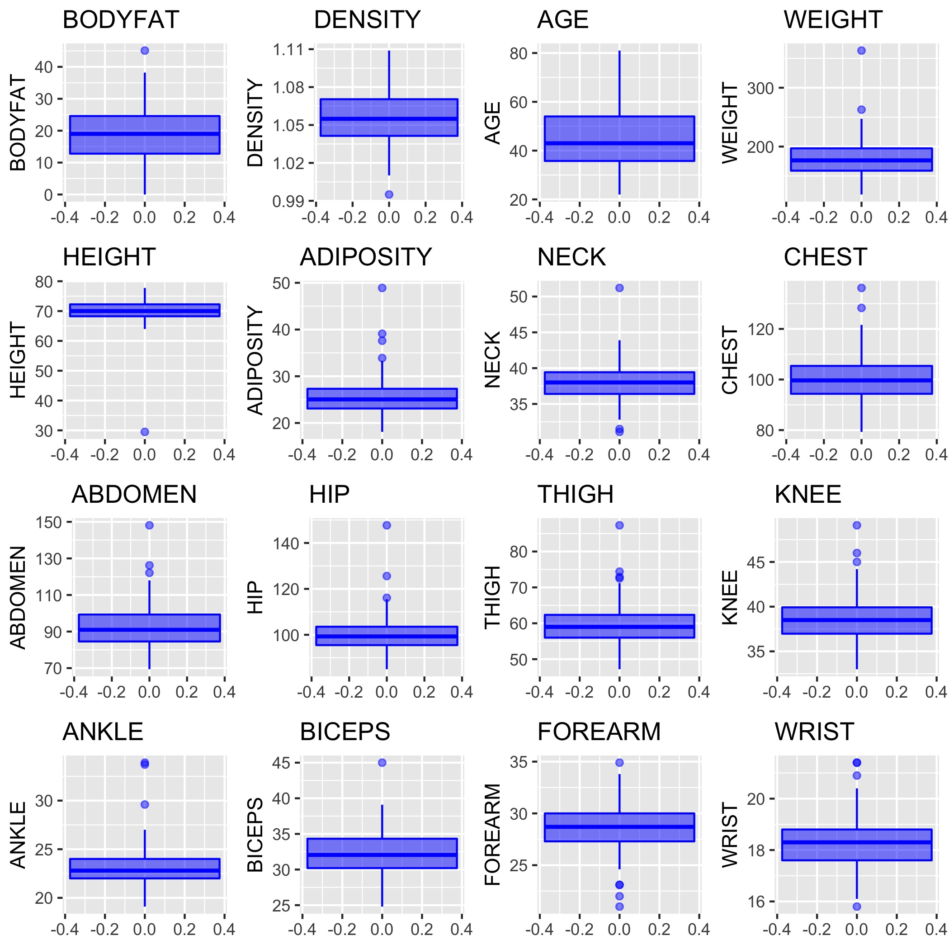
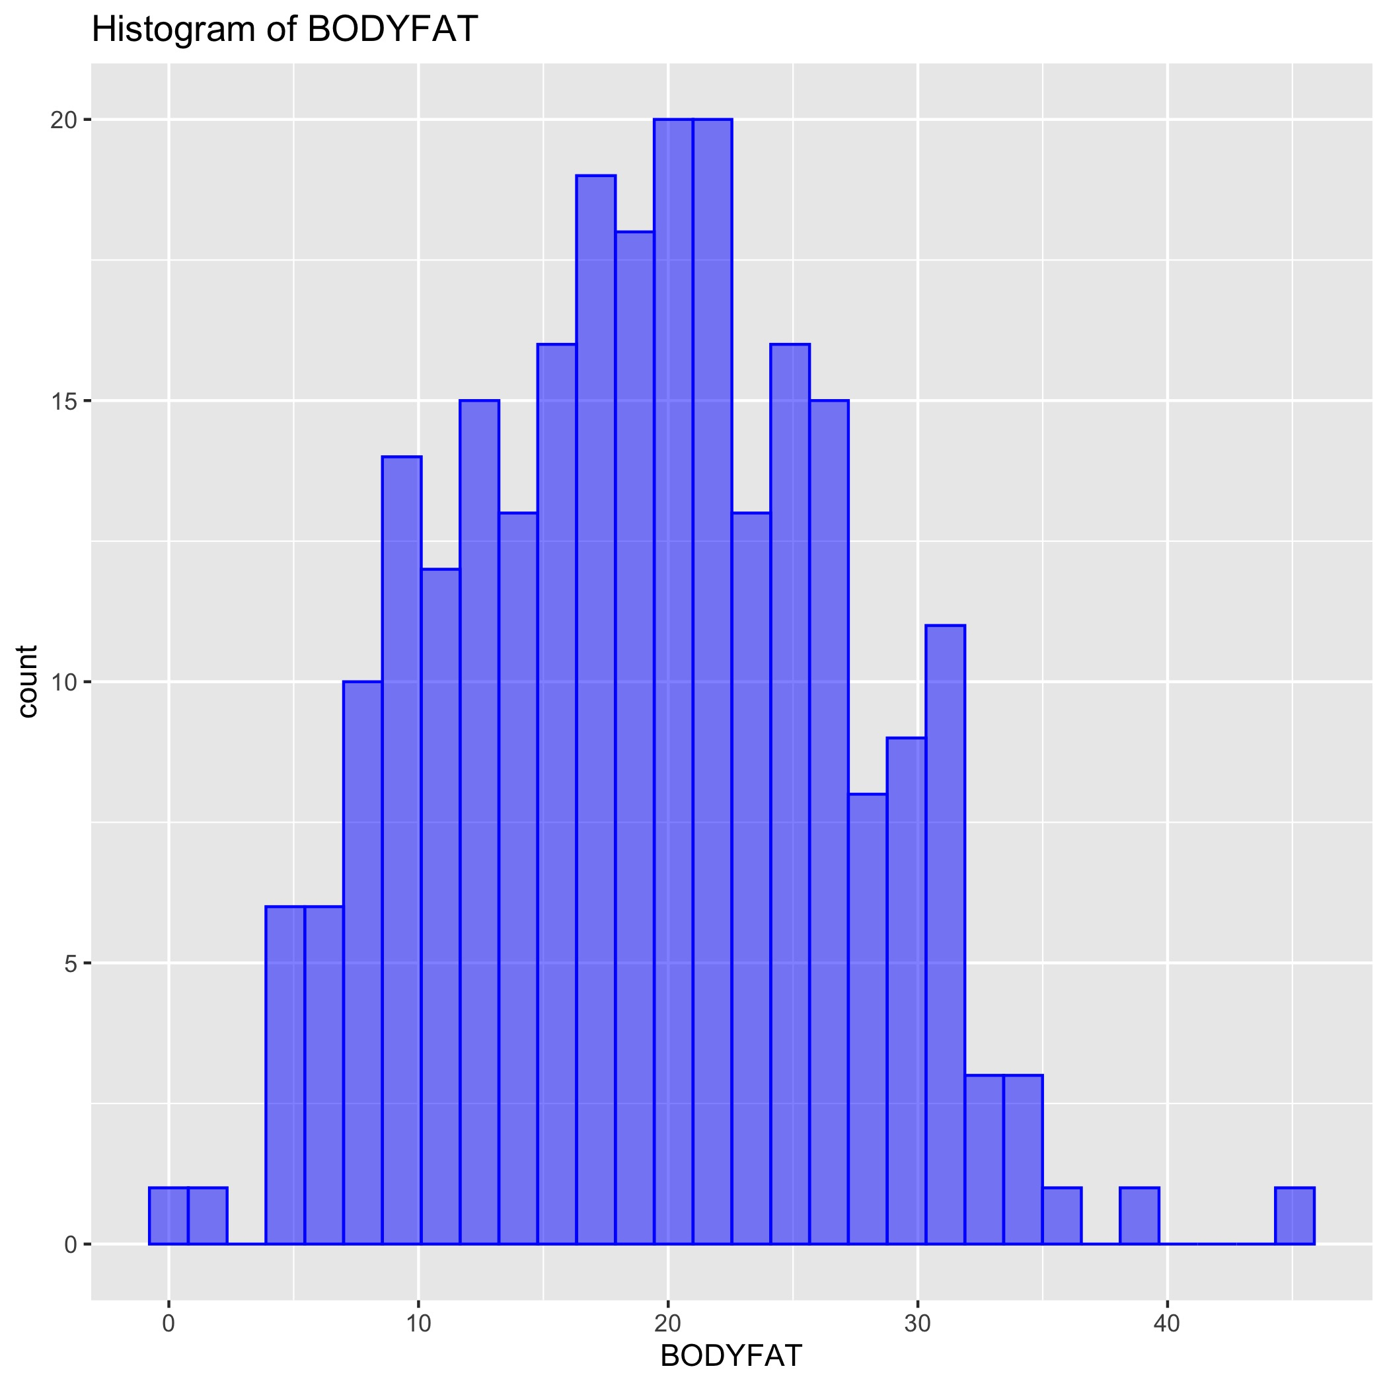
Data Analysis
252 observations and 16 valid variables.
Study data distribution and range.
Find any outliers.
Find any null and abnormal value

Slide 4
Data Clean - Boxplots
Outstanding outliers:
There are only about 250 observation, so we want to fix and keep as many outliers as possible.
IDNO | Reason | Method
182 | BODYFAT is 0, BODYFAT from Siri equation is negative | Remove
216 | Extreme value in BODYFAT | Keep
39 | Outliers from boxplots with extreme values | Keep, but it will be in influential observation in linear regression
42 | Low HEIGHT | Fix by BMI equation, update HEIGHT by 69 inches
41 | Outliers from boxplots with extreme values | Keep

Slide 5
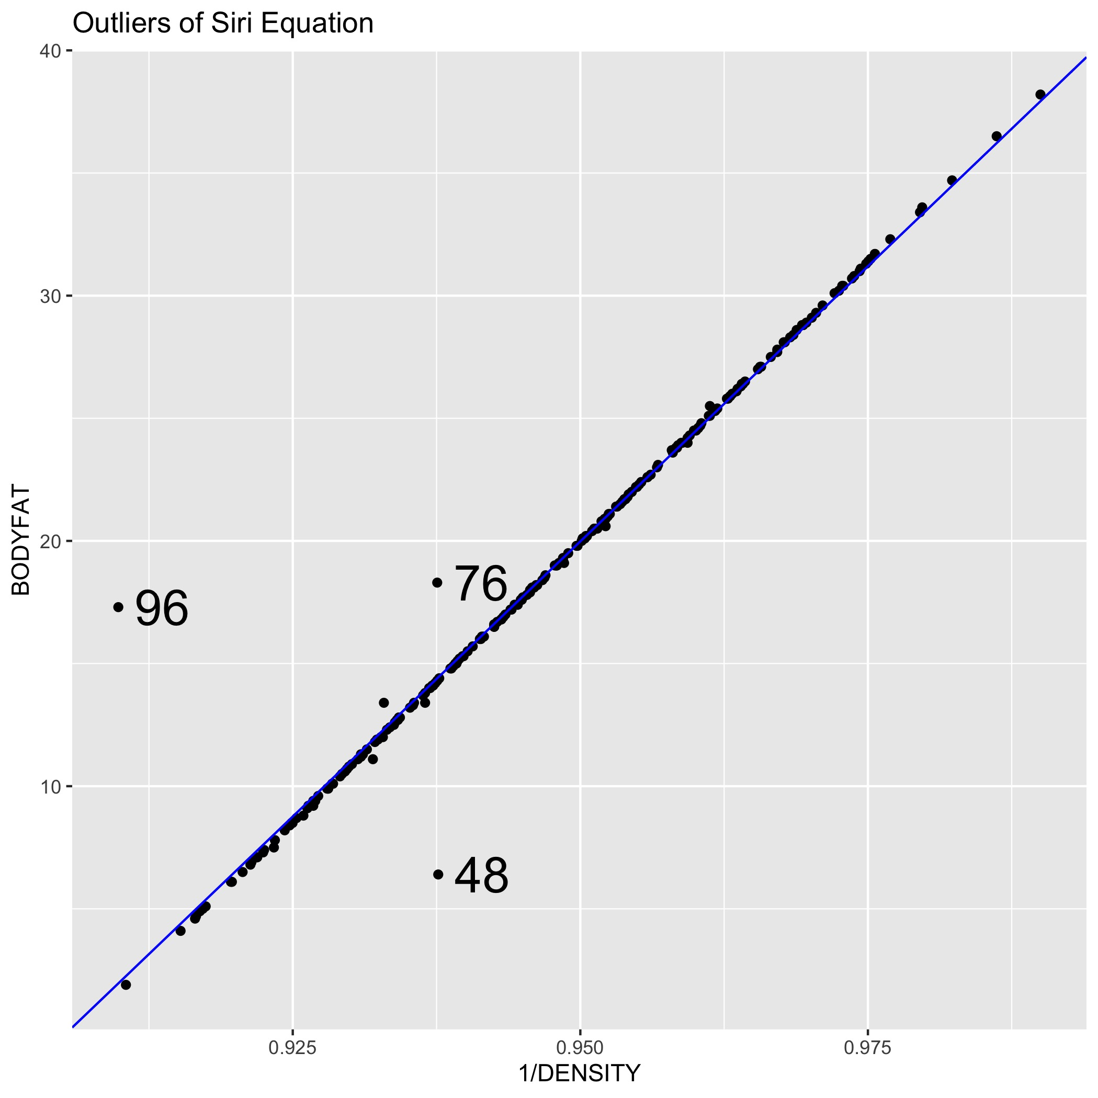
Data Clean – Siri Equation
Connection between BODYFAT and DENSITY in our data is called Siri equation.
Siri equation: BODYFAT=495/DENSITY-450.
Outstanding outliers in regression between BODYFAT and 1/DENSITY.
Beyond regression, the second method is to compare the new BODYFAT from Siri equation with initial one.
IDNO | Initial BODYFAT | New BODYFAT | Method
96 | 17.3 | 0.36 | Keep initial BODYFAT
76 | 18.3 | 14.09 | Update new BODYFAT
48 | 6.4 | 14.13 | Update new BODYFAT

Slide 6
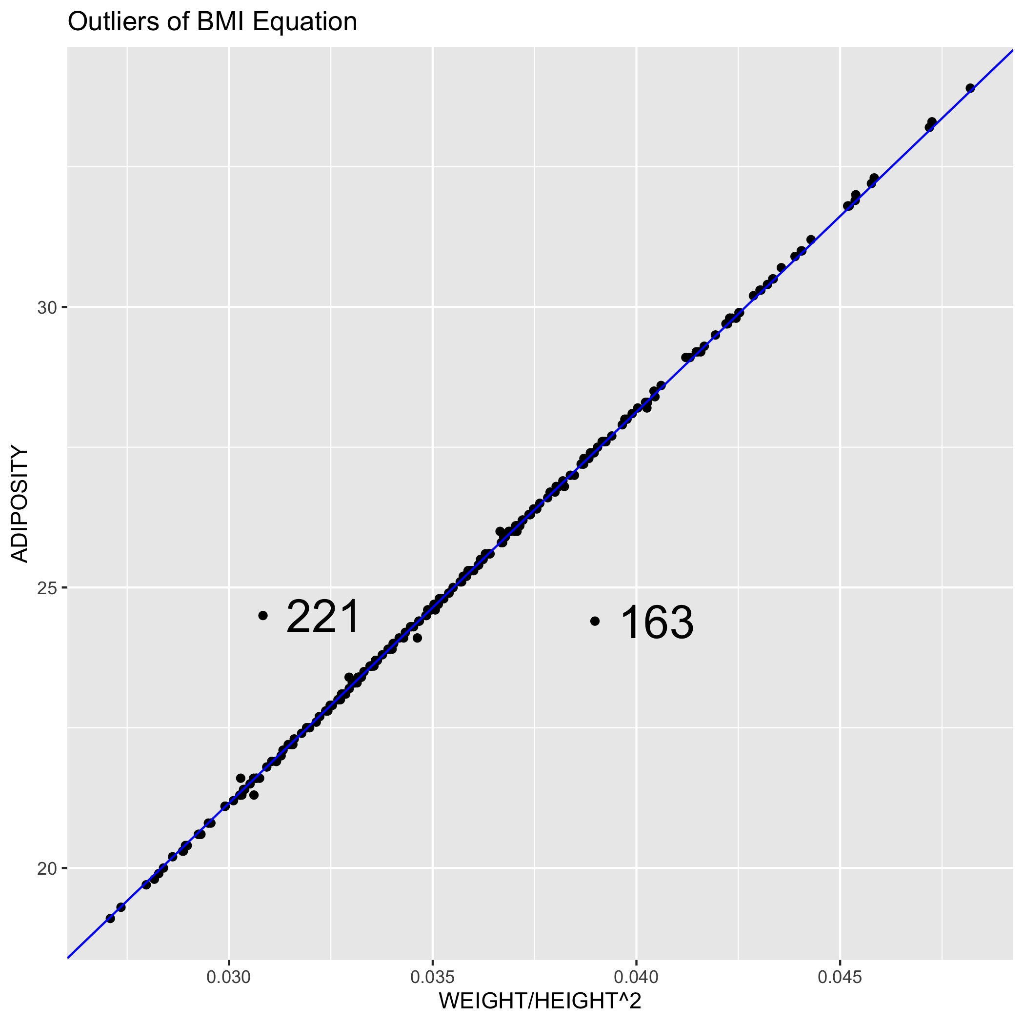

Data Clean – BMI Equation
Connection among ADIPOSITY, WEIGHT and HEIGHT in our data is called BMI equation:
BMI equation: ADIPOSITY=703 WEIGHT/HEIGHT²
Outstanding outliers in regression between ADIPOSITY and WEIGHT/HEIGHT².
Beyond regression, the second method is to compare the new ADIPOSITY from BMI equation with initial one.
IDNO | Initial ADIPOSITY | New ADIPOSITY | Method
163 | 24.4 | 27.4 | Update new ADIPOSITY
221 | 24.5 | 21.7 | Update new ADIPOSITY

Slide 7
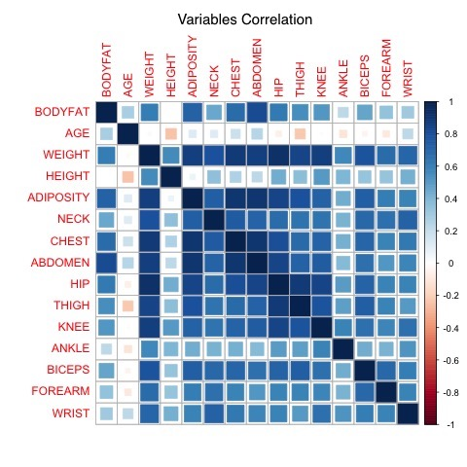
Clean Data - Summary
Table of how we deal with outliers:
There is only 252 observation, so we want to keep and fix as many outliers as possible. On the other hand, obesity is common in modern society, we also want to find their performance in model.
The final dataset contains 251 observations. There is high correlation among variables after clean in heat plot of correlation, which remind us to select variables.
ID | Method
182 | Delete for extreme value
42 | Fix HEIGHT by BMI equation
96 | Fix DENSITY by Siri equation
76 | Fix BODYFAT by Siri equation
48 | Fix BODYFAT by Siri equation
221 | Fix ADIPOSITY by BMI equation
163 | Fix ADIPOSITY by BMI equation

Slide 8
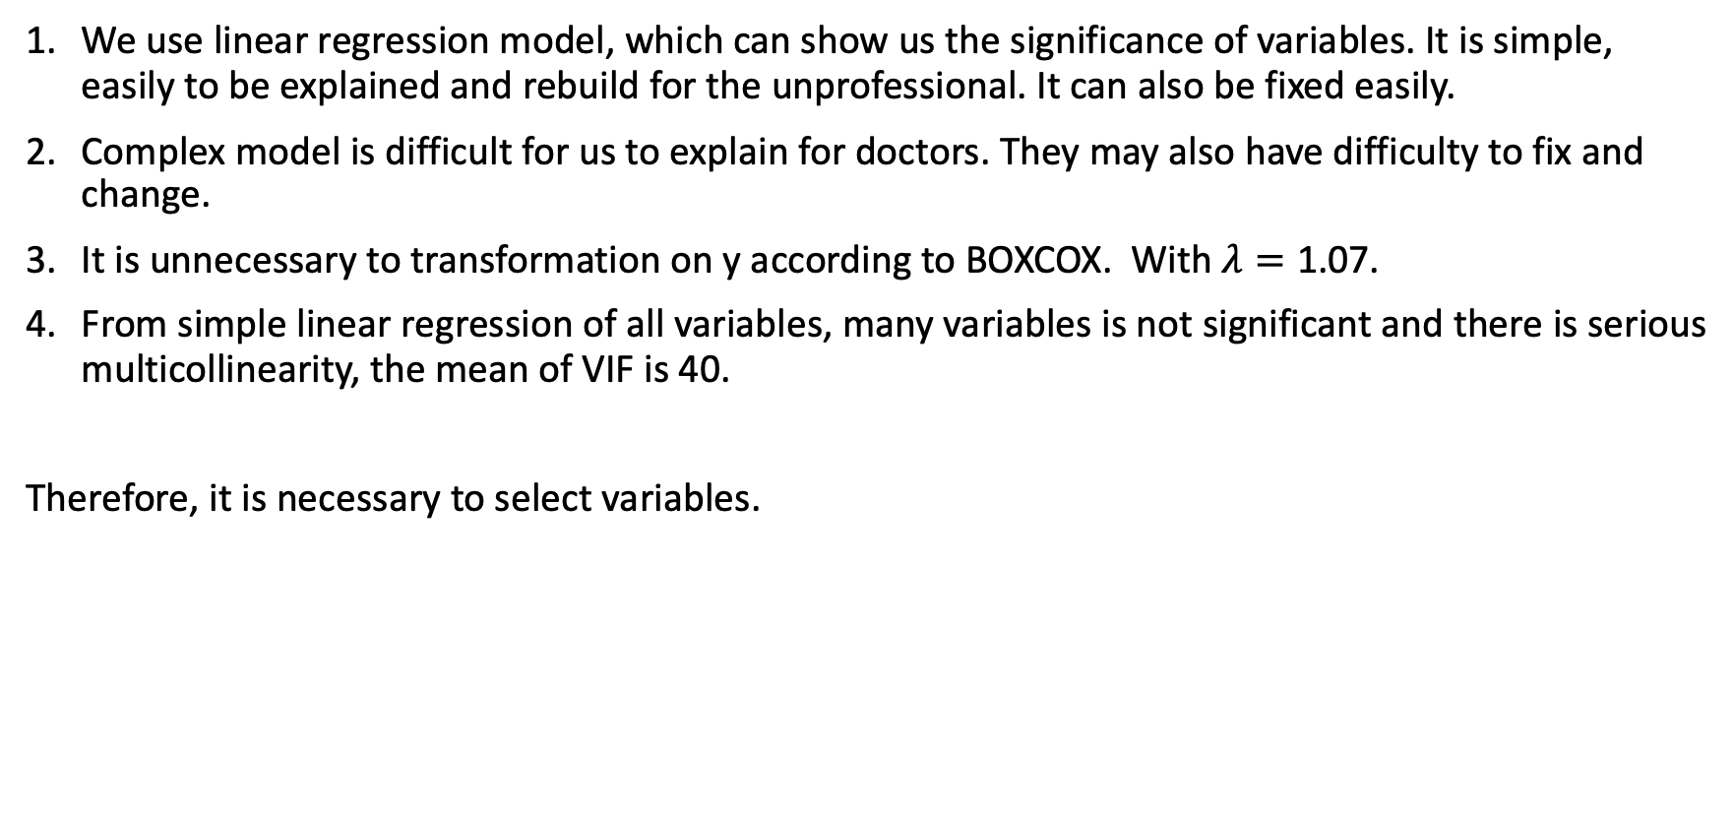
Variables Selection – Model Build
We use linear regression model, which can show us the significance of variables. It is simple, easily to be explained and rebuild for the unprofessional. It can also be fixed easily.
Complex model is difficult for us to explain for doctors. They may also have difficulty to fix and change.
It is unnecessary to transformation on y according to BOXCOX. With $λ=\text{1.0}\text{7}$.
From simple linear regression of all variables, many variables is not significant and there is serious multicollinearity, the mean of VIF is 40.
Therefore, it is necessary to select variables.

Slide 9
Variables Selection – Basic Idea
Method:
Tree regression, including bagging and boosting ones for select important variables
Subsets Method with Cp and BIC
Direction Search with AIC and BIC
We prefer both simple and precise model.
Full Model:
Four full model:
Full model with all variables: BODYFAT~AGE+WEIGHT+HEIGHT+ADIPOSITY+NECK+CHEST+ABDOMEN+HIP+THIGH+KNEE+ANKLE+BICEPS+FOREARM+WRIST
Full model with all variables after logarithmic (log(AGE)) transformation, from LogAGE to LogWRIST
Full model with all variables after square (AGE^2) transformation, from sqAGE to sqWRIST
Full model with all variables from 1, 2, 3, with AGE, LogAGE, sqAGE and others.
We still want to figure out any improvement after transformation on x

Slide 10
Variables Selection – Subsets Method
Subsets method find a subset of variables which are good to predict BODYFAT with better Rsquared or BIC
Here we only give results of full model 4 with all variables including square and log transformation.
BODYFAT~LogABDOMEN Adjusted Rsquared = 0.6674660
BODYFAT~ABDOMEN + sqWEIGHT Adjusted Rsquared = 0.7252191
BODYFAT~sqWRIST + sqWEIGHT + ABDOMEN Adjusted Rsquared = 0.7349010
From subsets method results of four full models, the ABDOMEN and its transformation is the most important variable. WEIGHT, WRIST are also very important.
There is no obvious improvement when the number of variables is more than 3.

Slide 11
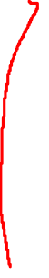
Variables Selection – Direction Search
Direction search find the best model by adding or removing variables from forward, backward and both directions for better BIC and AIC.
Here we only give results from forward direction search with BIC:
BODYFAT ~ ABDOMEN + WEIGHT + WRIST + FOREARM BIC=717.64
BODYFAT ~ LogABDOMEN + LogWEIGHT + LogWRIST BIC=714.86
BODYFAT ~ sqABDOMEN + sqWEIGHT + sqTHIGH BIC=725.31
BODYFAT ~ LogABDOMEN + WEIGHT + WRIST BIC=708.82
BIC will give simpler models than AIC.
ABDOMEN and its transformation is also the most important variable, followed by WEIGHT and WRIST.

Slide 12
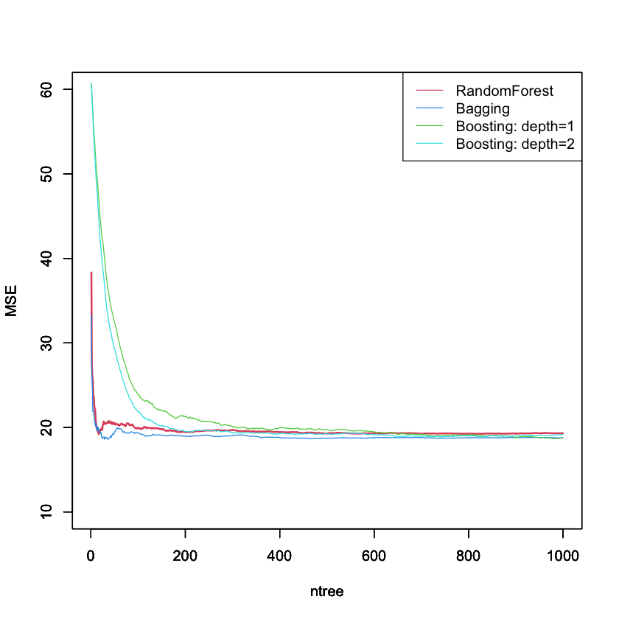
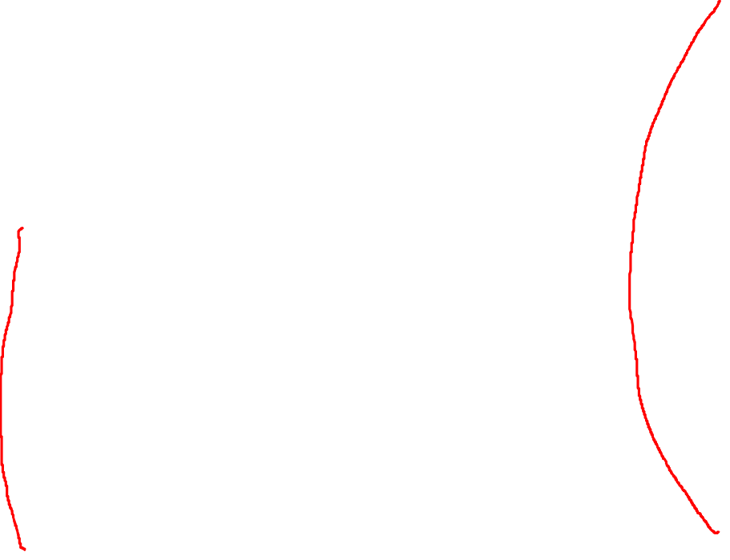
Variables Selection – Tree regression
Decision tree is a machine learning method that can be applied to both regression and classification problems. With decision tree, we can capture important variables if portion of data greatly changed when tree regression do binary splitting. We choose two best algorithms from their drop speed in MSE and got the rank of important variables below, you can refer to our code for detailed process.
Important Variables | Bagging | Boosting: depth=2
1 | ABDOMEN | ABDOMEN
2 | HEIGHT | ADIPOSITY
3 | WRIST | HEIGHT
4 | NECK | AGE
5 | WEIGHT | WRIST
6 | ADIPOSITY | BICEPS

Slide 13
Variables Selection – Summary
19 alternative models:
1 BODYFAT~ABDOMEN+HEIGHT+WRIST
2 BODYFAT~ABDOMEN+ADIPOSITY+HEIGHT
3 BODYFAT~ABDOMEN+WEIGHT+WRIST
4 BODYFAT~ABDOMEN+WEIGHT
5 BODYFAT~ABDOMEN
6 BODYFAT~LogABDOMEN+LogHEIGHT+LogWRIST
7 BODYFAT~LogABDOMEN+LogWEIGHT
8 BODYFAT~LogABDOMEN
9 BODYFAT~sqABDOMEN+sqWEIGHT+sqTHIGH
10 BODYFAT~sqABDOMEN+sqWEIGHT
11 BODYFAT~sqABDOMEN
12 BODYFAT~sqWRIST+sqWEIGHT+ABDOMEN
13 BODYFAT~ABDOMEN+sqWEIGHT
14 BODYFAT~ABDOMEN+WEIGHT+WRIST+FOREARM
15 BODYFAT~LogABDOMEN+LogWEIGHT+LogWRIST
16 BODYFAT~LogABDOMEN+WEIGHT+WRIST
17 BODYFAT~LogHEIGHT+LogNECK+LogABDOMEN+LogWRIST
18 BODYFAT~sqWEIGHT+sqABDOMEN+sqFOREARM+sqWRIST
19 BODYFAT~ABDOMEN+THIGH+WRIST+LogAGE+LogTHIGH
In models selection, we prefer both simple and precise ones.
We do not choose models with more than 5 variables, in the following steps you will see it is unnecessary to choose too complex models.

Slide 14
Model Selection
We use 30 - repeated with 10 - fold cross validation, which can give stabler results than cross validation without repeat. The root mean squared error and R-squared: Part of results:
ID | Model | Root Mean Squared Error | R-squared
17 | BODYFAT~LogHEIGHT+LogNECK+LogABDOMEN+LogWRIST | 3.976405 | 0.7392734
12 | BODYFAT~sqWRIST+sqWEIGHT+ABDOMEN | 3.937780 | 0.7384296
6 | BODYFAT~LogABDOMEN+LogHEIGHT+LogWRIST | 4.003707 | 0.7335260
3 | BODYFAT~ABDOMEN+WEIGHT+WRIST | 4.059024 | 0.7270816
4 | BODYFAT~ABDOMEN+WEIGHT | 4.110360 | 0.7245327
1 | BODYFAT~ABDOMEN+HEIGHT+WRIST | 4.139776 | 0.7241520
18 | BODYFAT~sqWEIGHT+sqABDOMEN+sqFOREARM+sqWRIST | 4.109423 | 0.7219854
10 | BODYFAT~sqABDOMEN+sqWEIGHT | 4.174410 | 0.7149131
2 | BODYFAT~ABDOMEN+ADIPOSITY+HEIGHT | 4.183036 | 0.7144738
11 | BODYFAT~sqABDOMEN | 4.690806 | 0.6615653

Slide 15
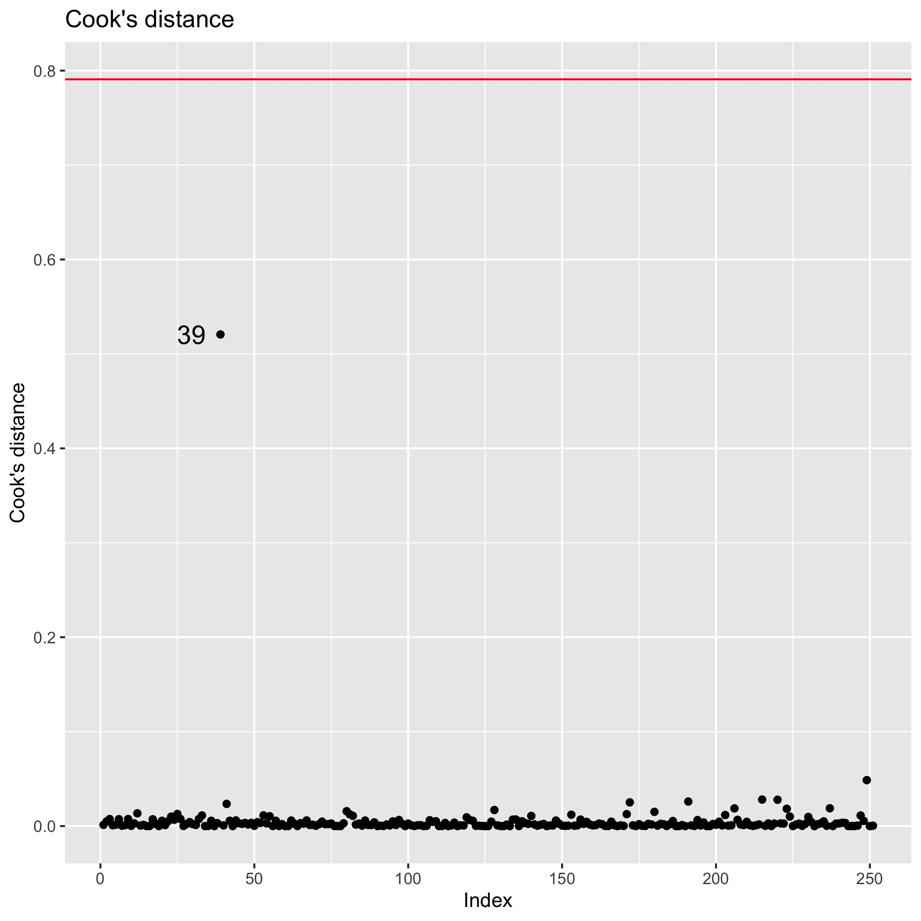
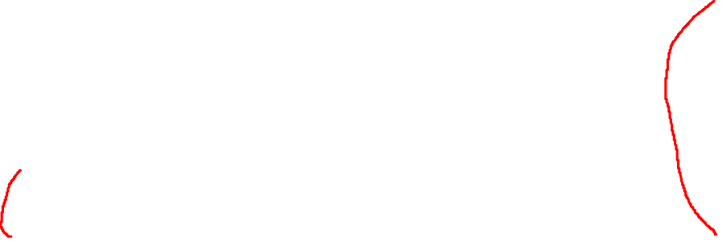
Model Diagnosis and Summary
We choose ABDOMEN, WEIGHT as our predictors.
Final model without influential observation ID39 in Cook’s Distance of initial model:
BODYFAT(%)=0.899 ABDOMEN-0.123 WEIGHT-42.27.
Rule of thumb: BODYFAT(%)=abdomen circumference(cm)*0.899 minus weight(lbs)*0.123 minus 42.27.
Adjusted R squared is 0.72.
Residual standard error is 4.04.
All variables are significant.
No serious multicollinearity, mean VIF=4.0.
Example: Man with 154 lbs WEIGHT and 85 cm ABDOMEN, his BODYFAT will be 15(%).
Coefficients | Estimate | Std Error | P-value | 95% CI Lwr | 95% CI Upr
Intercept | -42.27 | 2.446 | < 2e-16 | -47.087 | -37.450
ABDOMEN | 0.899 | 0.052 | < 2e-16 | 0.798 | 1.001
WEIGHT | -0.123 | 0.019 | 1.37e-09 | -0.161 | -0.084

Slide 16
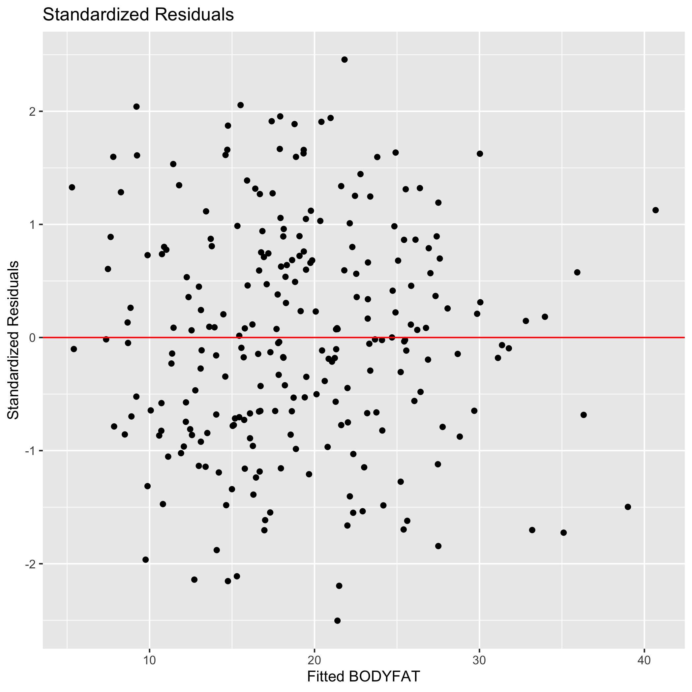
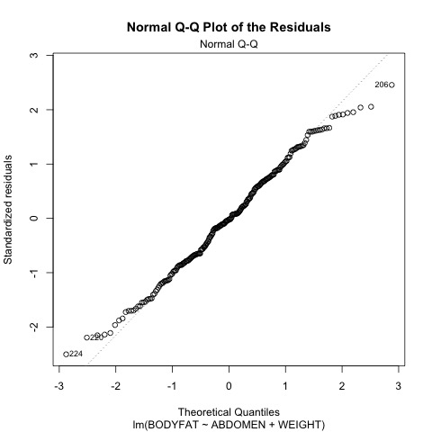
Model Diagnosis – Standardized Residuals, QQ plots for Residuals

Slide 17
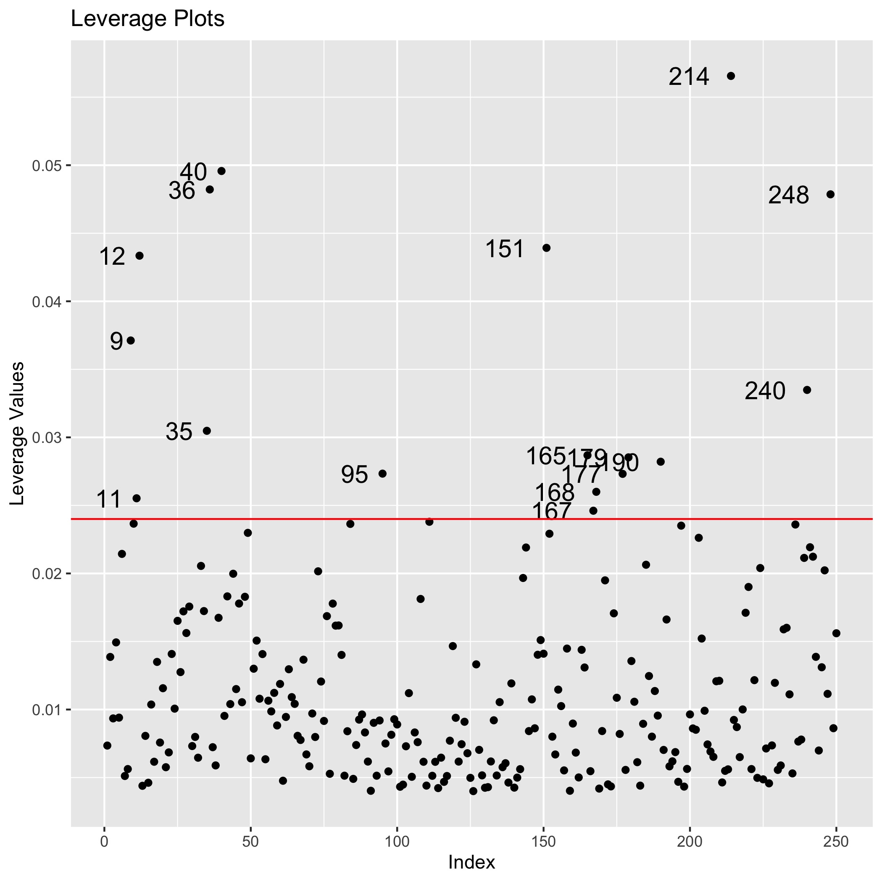
Model Diagnosis – Leverage Plots
The leverage is diagonal elements from 𝐻=𝑋(𝑋′𝑋)⁻¹𝑋′
There is some outliers in Leverage plots, which show the outliers when we take ABDOMEN and WEIGHT as predictors.

Slide 18
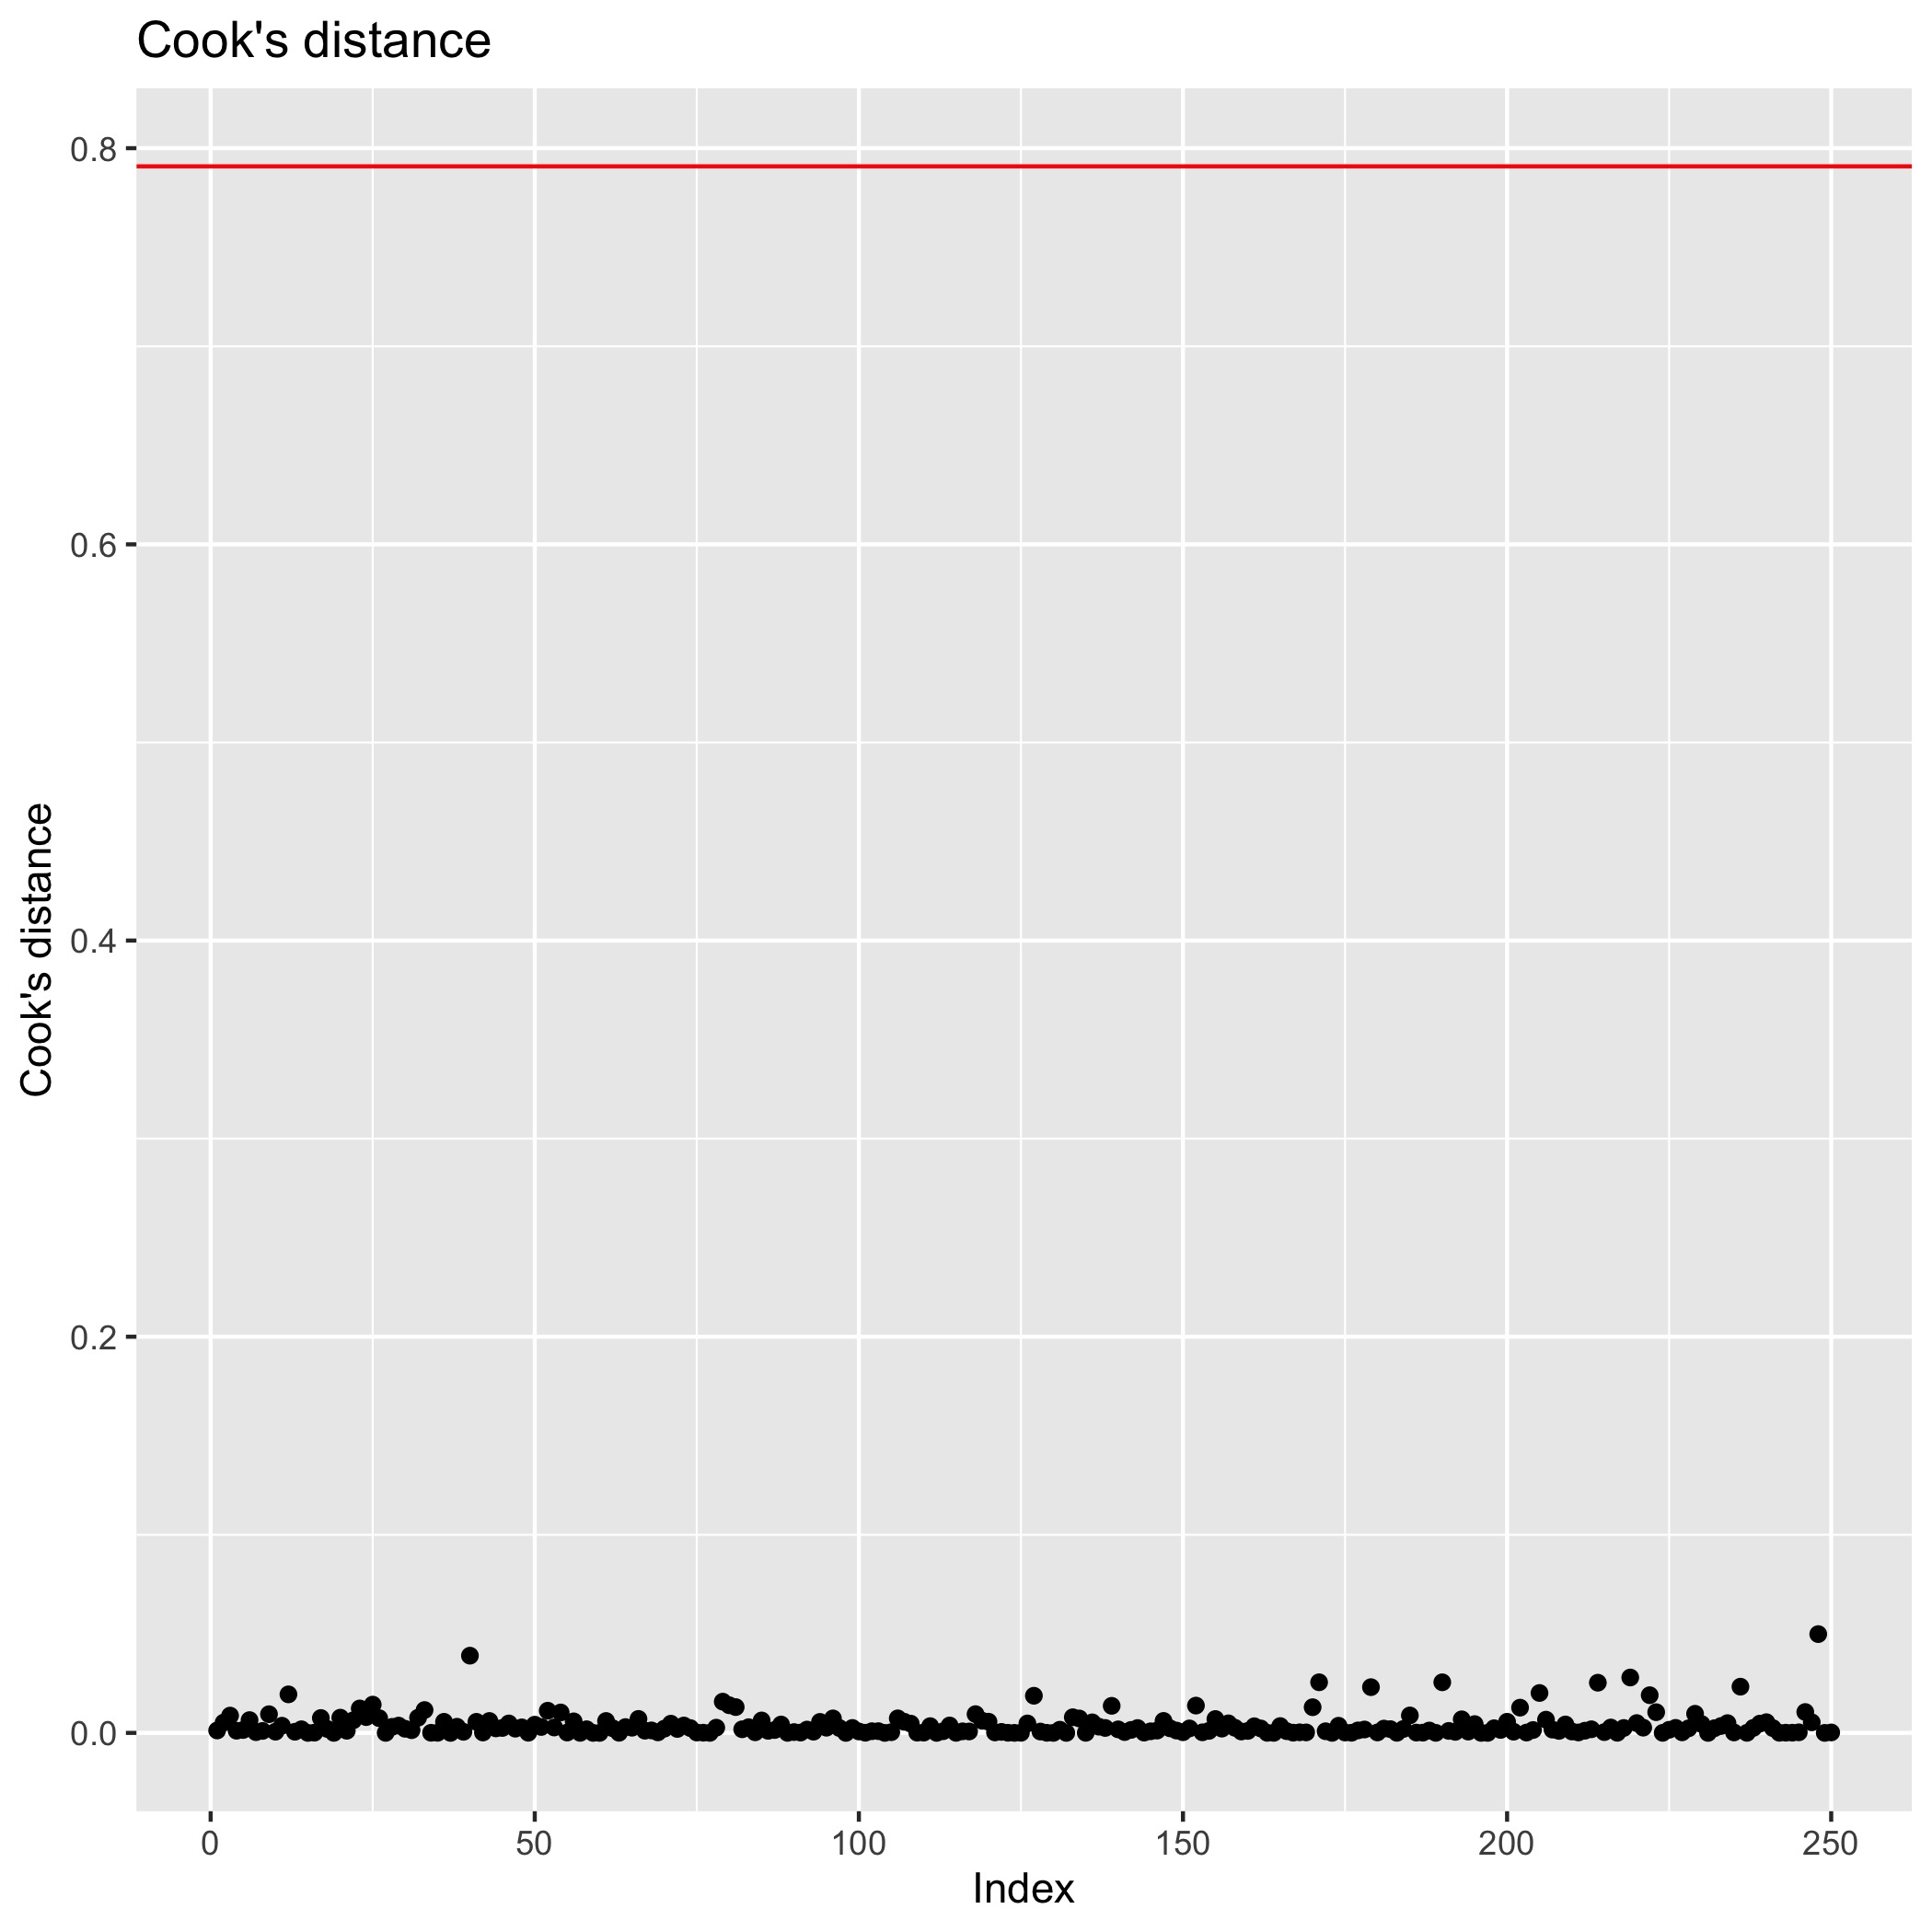
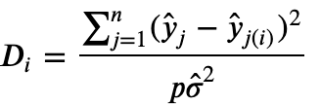
Model Diagnosis – Cook’s Distance
Cook’s distance
measure the influence of i^{th} observation on all n fitted values.
The red line is rule of influential observation.
No influential observation after removing ID39.

Slide 19
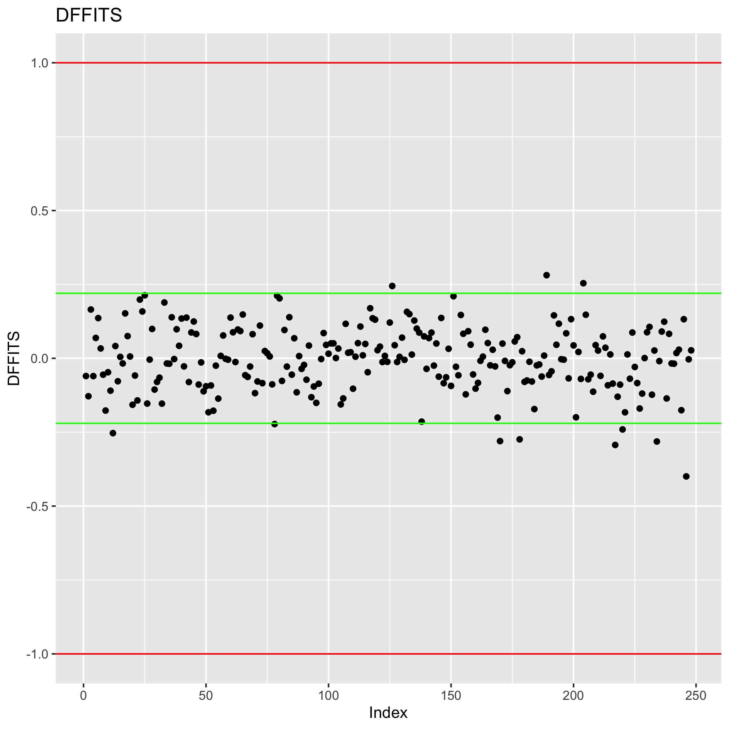
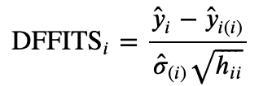
Model Diagnosis - DFFITS
DFFITS
measures the influence of the i^{th} observation on the fitted value y_{i}.
The rule of influential observation for small dataset is red lines, for large dataset is green lines.
No obvious influential observation.

Slide 20
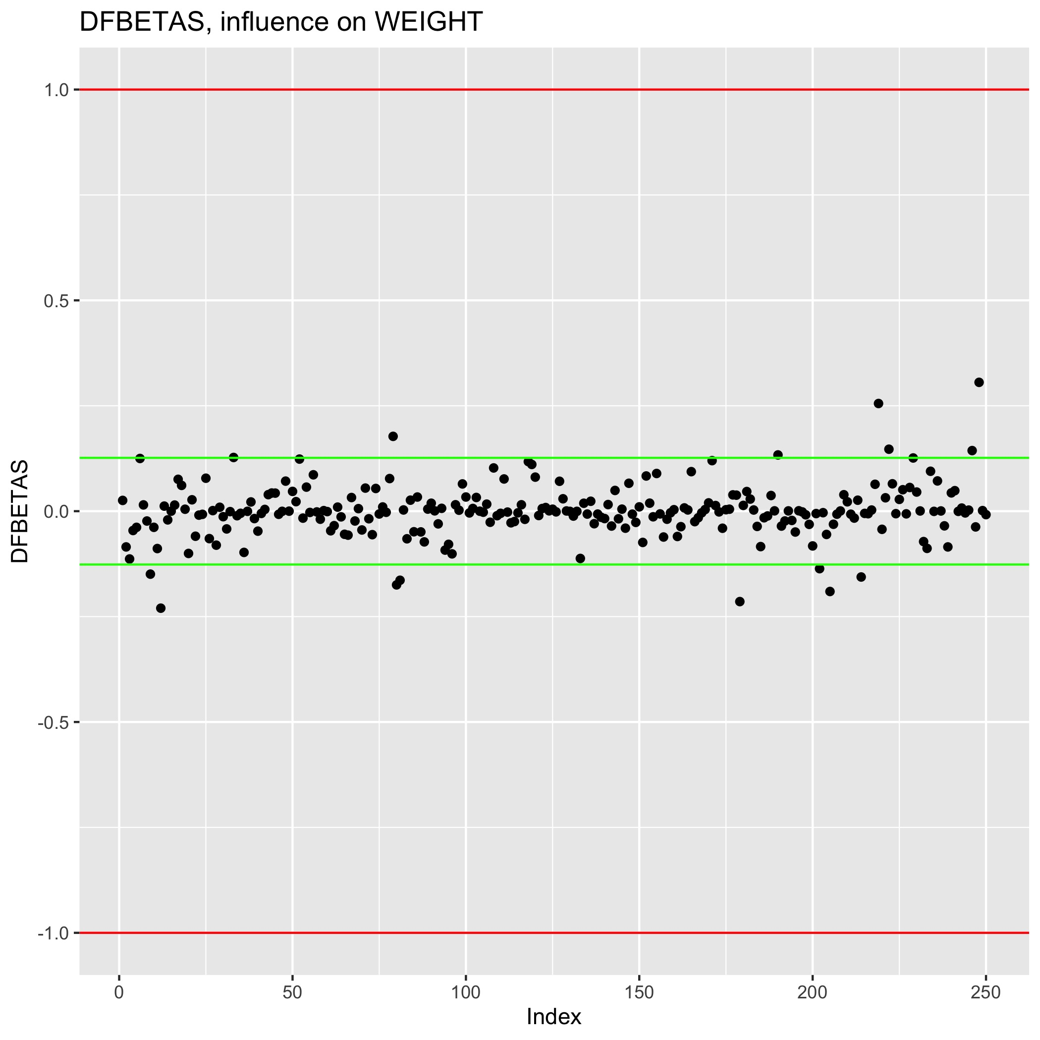
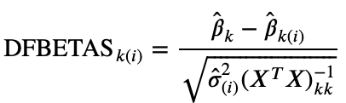
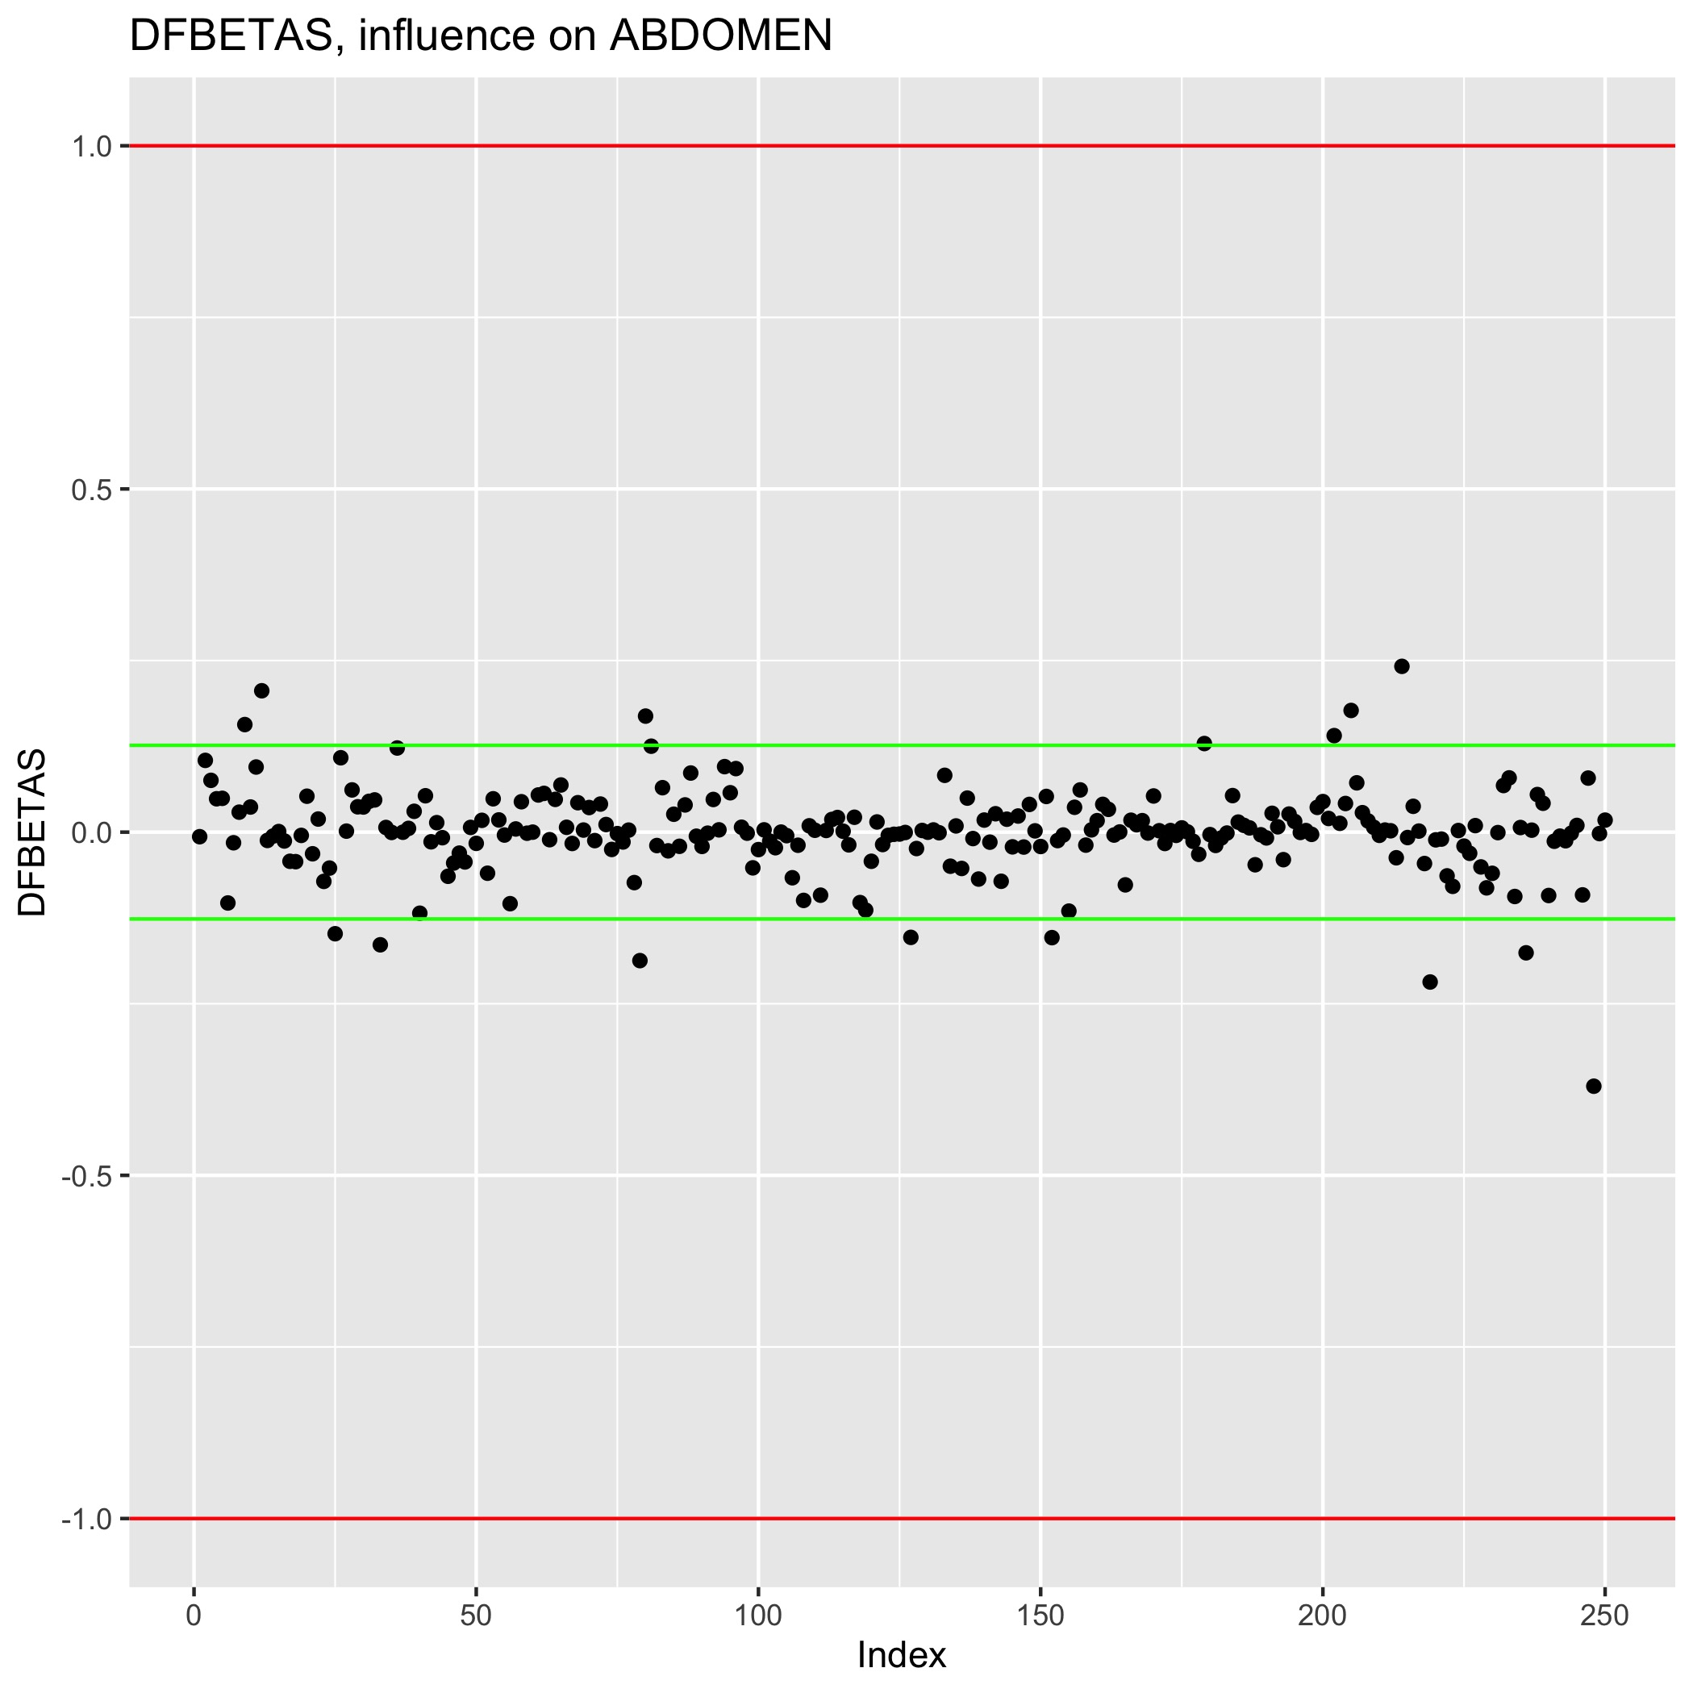
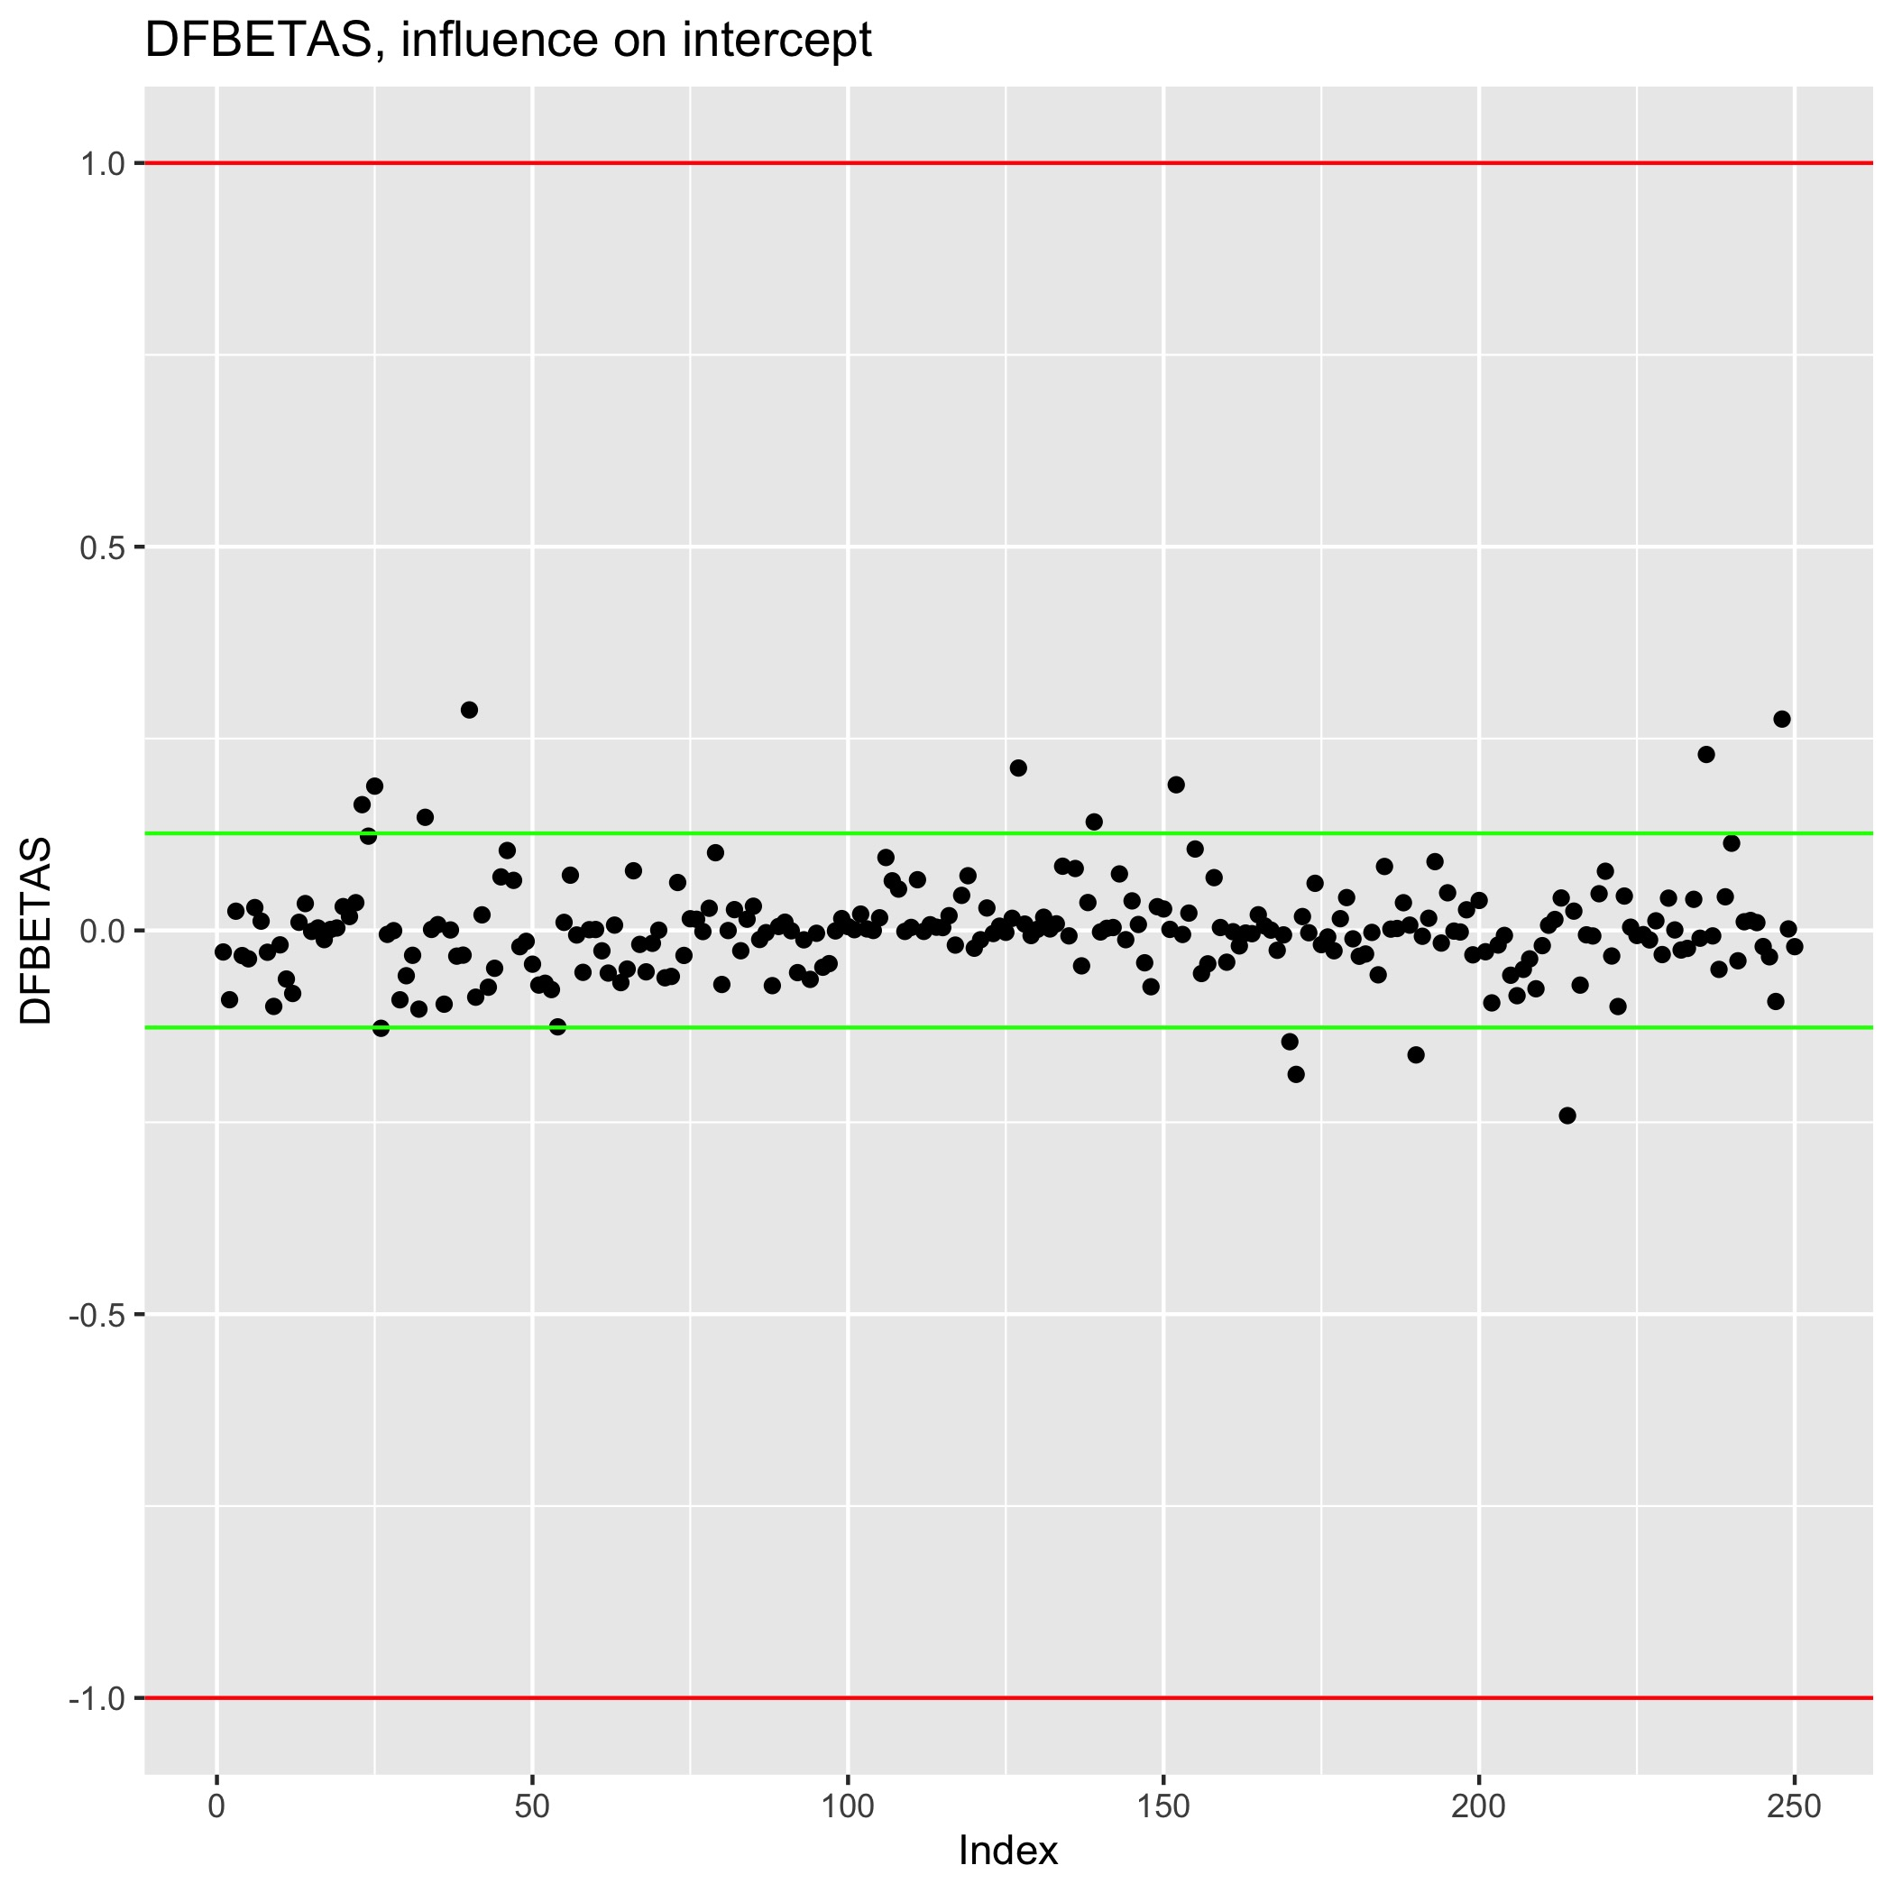
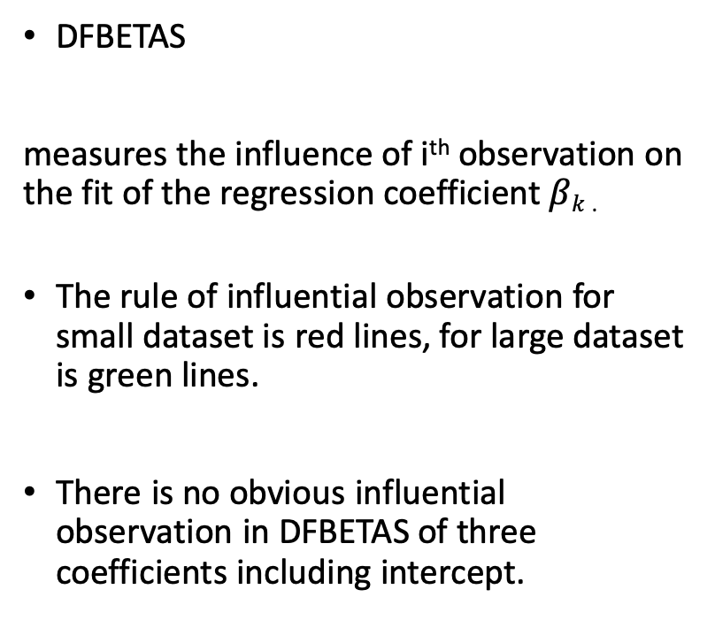
Model Diagnosis - DFBETAS
DFBETAS
measures the influence of i^{th} observation on the fit of the regression coefficient $βk$ .
The rule of influential observation for small dataset is red lines, for large dataset is green lines.
There is no obvious influential observation in DFBETAS of three coefficients including intercept.
Notes:
nhhhh

Slide 21
Model Diagnosis and Summary
Advantages:
Perform well in diagnosis.
Simple rule with only two inputs.
No serious multicollinearity.
All linear regression assumptions hold.
Disadvantages:
The R-squared is not perfect.
Sacrifice precision for simplicity.
Improvement:
We expect large and detailed data sets.
Is there any improvement for new variables from complex transformation and combination?

Slide 22
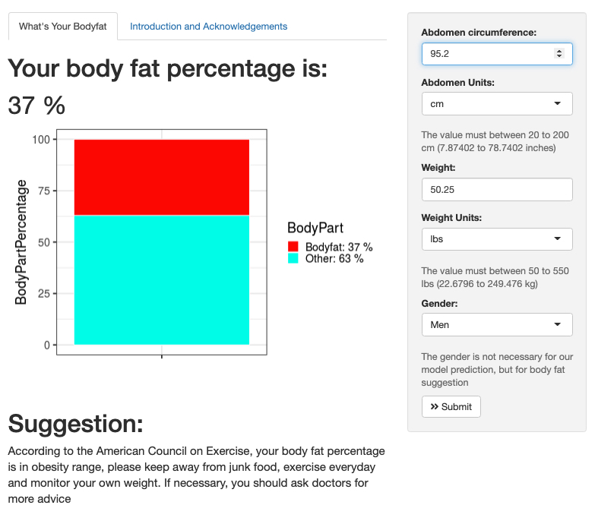
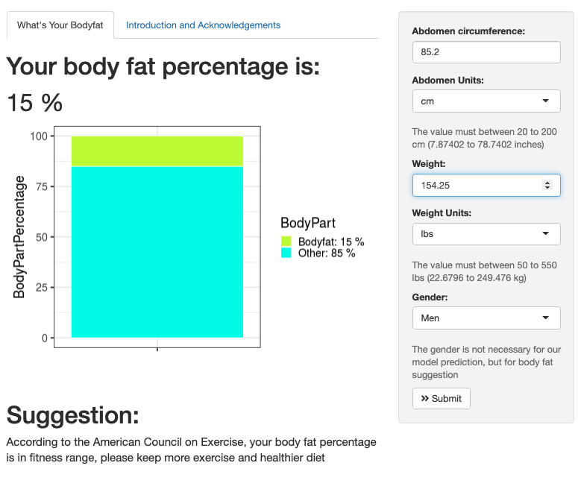
Shiny Application
Function of changing unit.
Color warning when your bodyfat is high.
Body fat suggestion from American Council on Exercise
Welcome use it in https://ewang36.shinyapps.io/Bodyfat/

Slide 23
Acknowledge
GitHub, Main Code
Main code edited by CHENYANG JIANG and ENZE WANG
Tree regression edited by HanGyu KANG
Model selection fixed by RUI HUANG
GitHub maintained by ENZE WANG
Shiny App
Main edited by RUI HUANG and HanGyu KANG
The interface, ggplot and unit part are fixed, edited and maintained by ENZE WANG
Other problems are fixed by CHENYANG JIANG
Presentation
PPT edited by ENZE WANG
Video edited by HanGyu KANG
Presented with CHENYANG JIANG and RUI HUANG
PDF Summary
Main edited by ENZE WANG
Fixed by RUI HUANG, CHENYANG JIANG and HanGyu KANG

